Slide 1

Web/Python Programming
웹/파이썬 프로그래밍

Slide 2
Today
Storing data using other collection types
Review lists
Sets
Tuples
Dictionaries
You will be able to pick the one that best matches your problem to keep your code as simple and efficient as possible.

Slide 3
List is a type
Integer
Float
Boolean
String
Lists contain 0 or more objects
Collection of data!

Slide 4
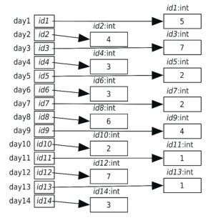
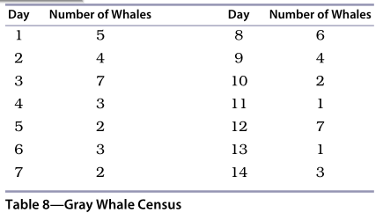

Collection of data
Number of gray whales counted near the Coal Oil Point Natural Reserve

Slide 5
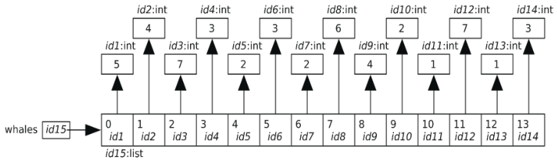
List
List is a type
A list is an object
An object can be assigned to a variable
id1: float
degrees_celsius
id1
26.0

Slide 6

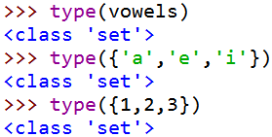

Set is a type
A set is an unordered collection of distinct items
Unordered: items are not stored in any particular order
Distinct: Any item appears in a set at most once. No duplicates

Slide 7
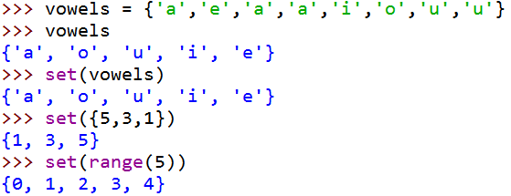


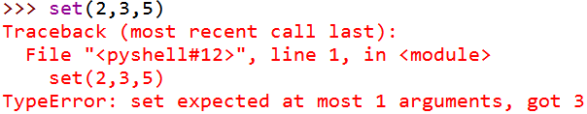
How to define a set
An empty set is not {}
Function set takes either no arguments or a single argument
Function set takes a list, a set, a range, and a tuple as an argument
Notes:
Set에서 empty만들 때 주의할 것.
집합은 중복 요소도 제거해주며 리스트, range도 집합으로 바꿔준다.
집합에서는 순서를 신경쓰지 않고 사용자도 그 순서를 굳이 바꾸거나 할 이유가 없다.

Slide 8
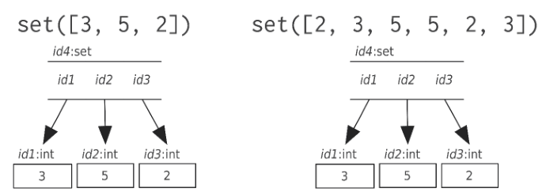
Set: memory model

Slide 9
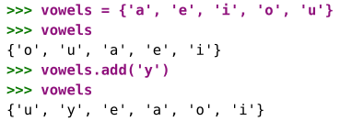
Set operations
In python, set operations are implemented as set methods

Slide 10
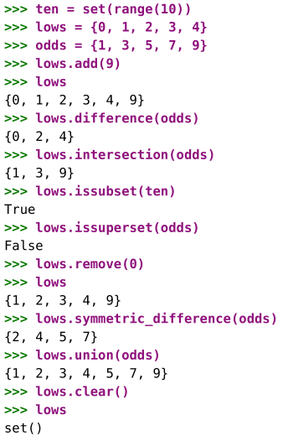
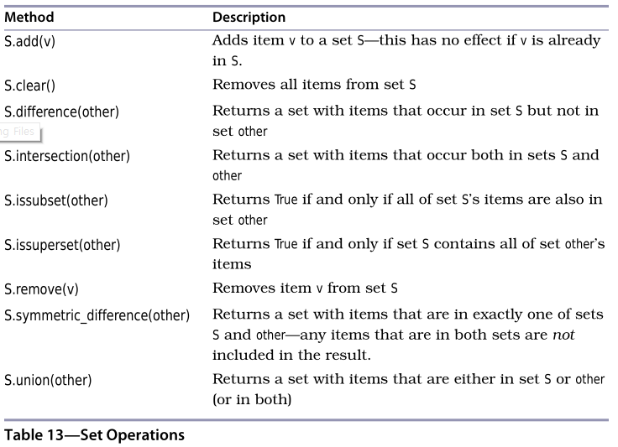
Set methods

Slide 11
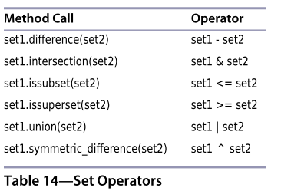
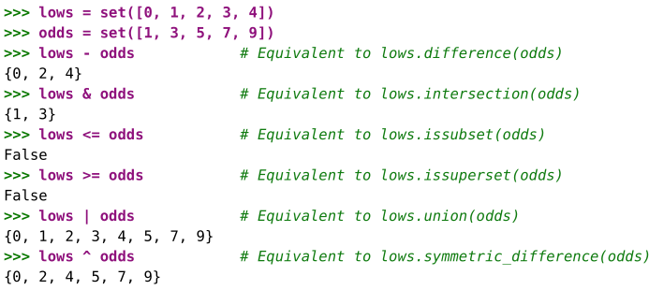
Set operators
Notes:
Add 함수는 중복성을 알아서 제거하여 더한다.

Slide 12
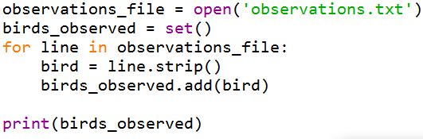
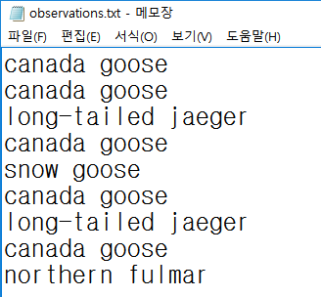

Set example: Arctic birds

Slide 13
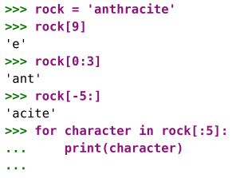
Recall string
String is an immutable sequence of characters.
The characters in a string are ordered.
A string can be indexed and sliced like a list to create new strings.

Slide 14
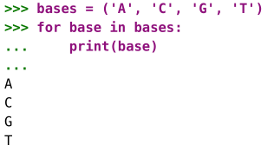
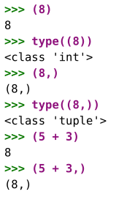
Tuple is a type
Tuple is another immutable sequence type.
Tuples are defined using parentheses.
Tuples can be subscripted, sliced, and looped over.
The empty tuple is ()
A Tuple with one element is (x,)
Notes:
값을 바꿀일이 없을 때 주로 쓴다.
튜플을 만들때 기본적으로 반드시 쉼표를 찍어야한다. (하나 이상쓰려면…)
그냥 숫자만 쓴다면 정수로 받아들임

Slide 15
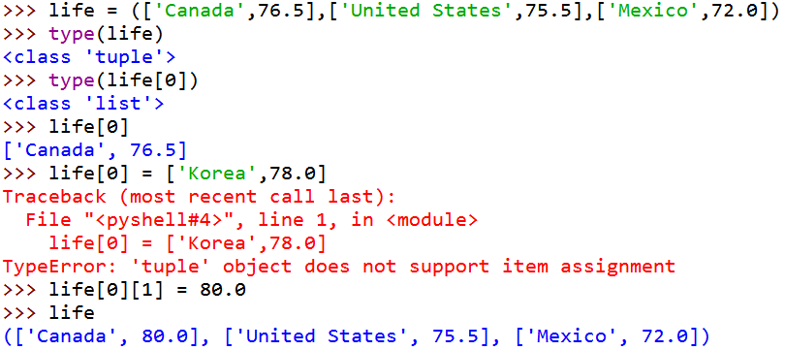
Tuple is immutable
The references contained in a tuple cannot be changed after the tuple has been created, though the objects referred to may themselves be mutated.
Notes:
튜플의 아이템을 건드릴 수는 없는데 튜플안에 있는 리스트 in 리스트의 주소 & 그 값을 바꿀 순 있다.
즉 life[0]은 튜플의 아이템이고
Life[0][0] or life[0][1]은 리스트의 아이템으로 본것

Slide 16

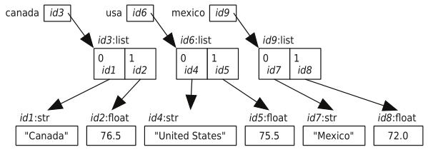
Tuple: memory model

Slide 17

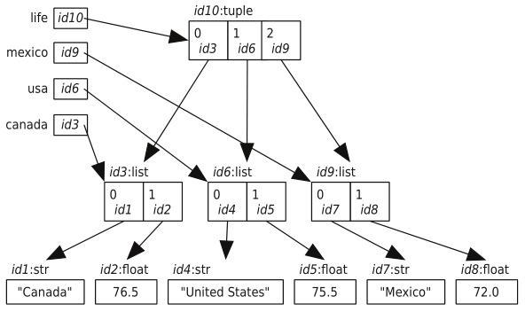
Tuple: memory model

Slide 18
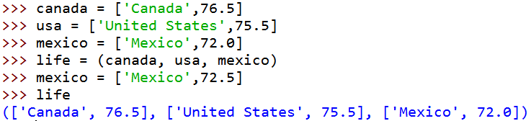
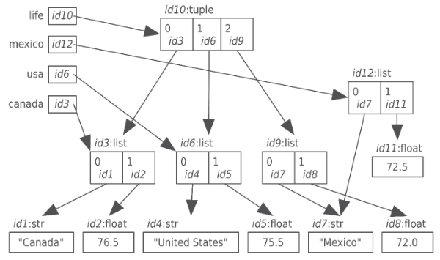
Tuple: memory model

Slide 19

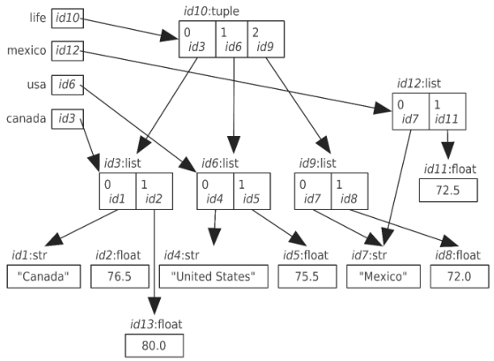
Tuple: memory model

Slide 20
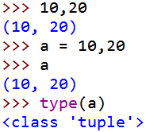
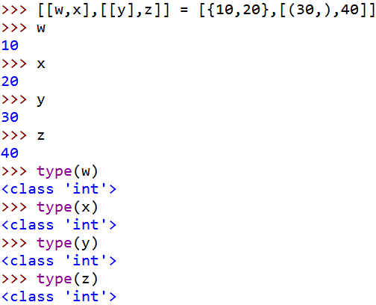
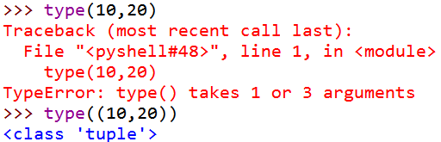
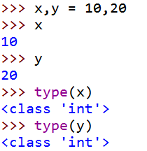
Multiple assignment

Slide 21

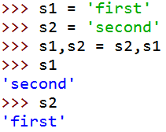
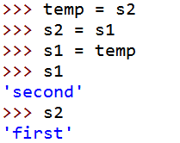
Multiple assignment: swap
Traditional way to swap
Swap in Python

Slide 22
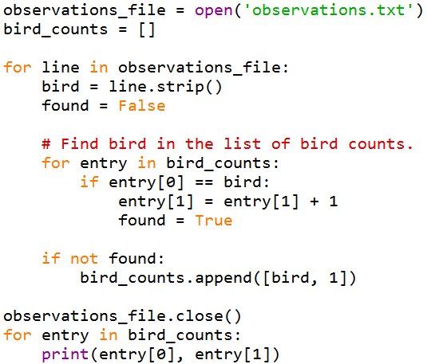
Dictionary: intro
If the list is very long, scanning the list of names each time we want to add a new observation would take a long, long time

Slide 23
Dictionary (a.k.a. map)
A dictionary is an unordered mutable collection of key/value pairs
English dictionaries map words to definitions
Python dictionaries map a key to a value
The keys form a set.
Any key can appear once at most in a dictionary
Keys must be immutable
Values are mutable

Slide 24
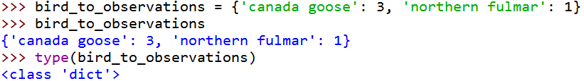
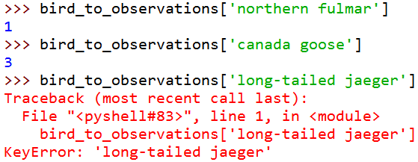
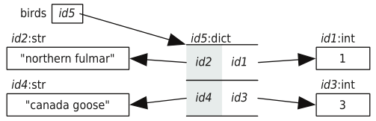
Dictionary example
An empty dictionary is {}
Notes:
{ key : value}
Key는 바뀌면 안되는 값이다. Value는 바꿔도 상관없다.
Key값이 Logical한 index역할을 하는셈

Slide 25
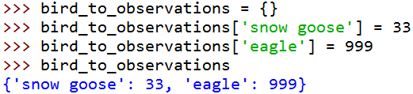

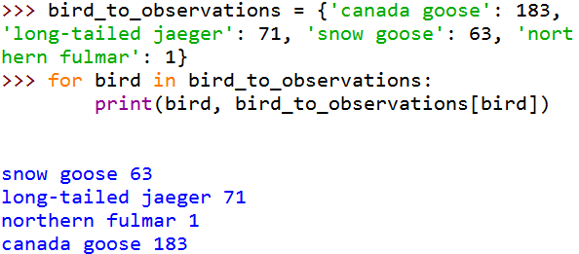

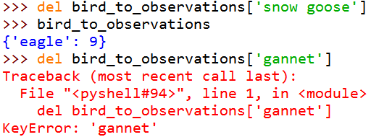
Updating and checking membership/ Looping over dictionaries

Slide 26
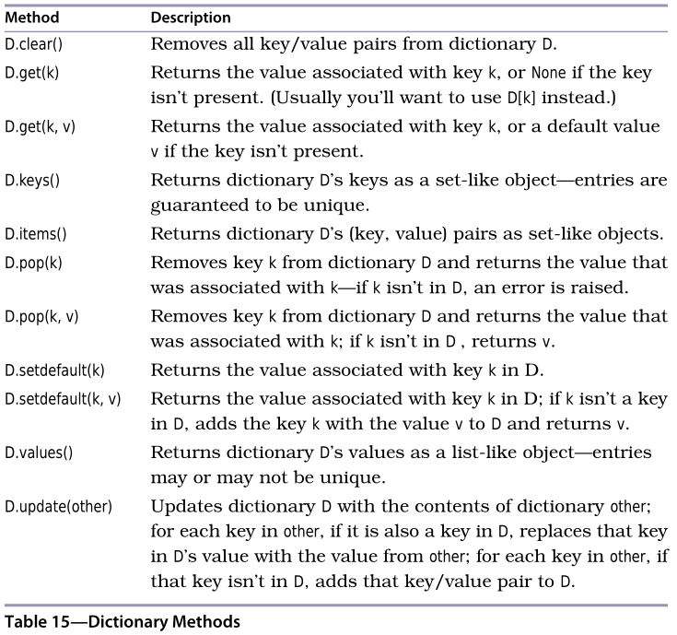
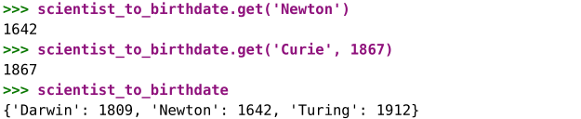
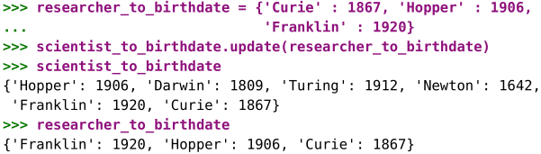

Dictionary operations

Slide 27
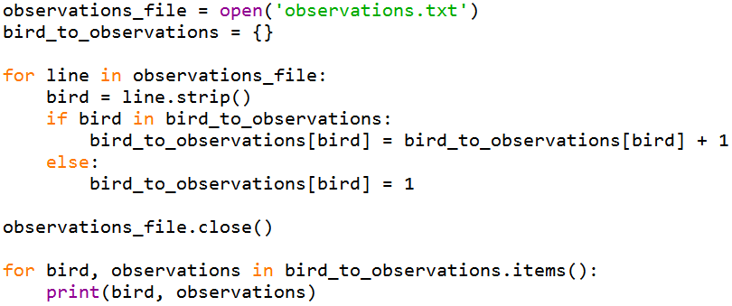
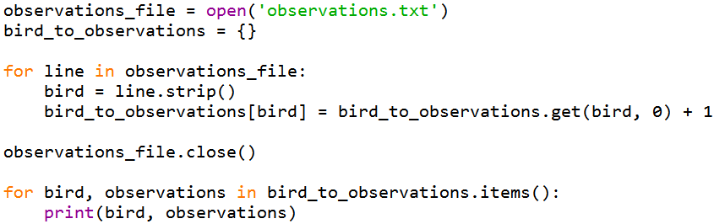
Dictionary examples
Notes:
4줄을 1줄로 줄일 수 있고 성능도 좋아짐.

Slide 28
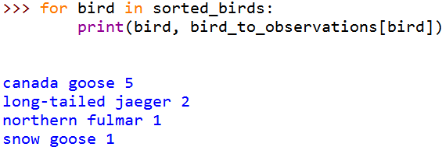

Dictionary examples

Slide 29
Inverting a dictionary
Keys -> Values
Values -> Keys
No guarantee that values are unique
Ex) inverting {‘a’:1, ‘b’:1, ‘c’:1} ?
{1: [‘a’, ’b’, ’c’]} is possible
Notes:
거의 사용하지 않음…
Key의 경우 중복또한 존재하기 때문… ex; 학번&이름 (이름은 중복이 존재한다)

Slide 30

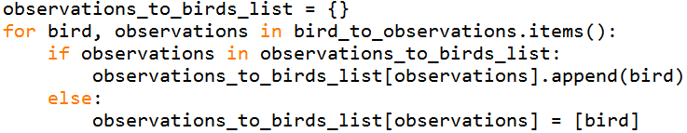
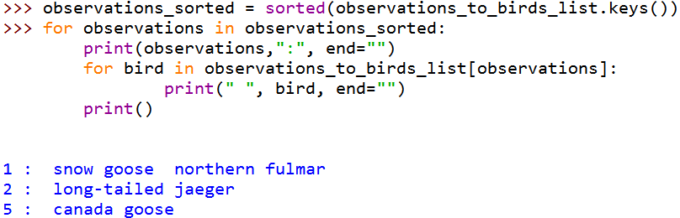
Inverting a dictionary

Slide 31
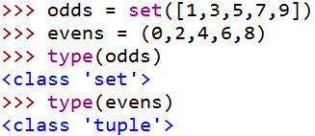
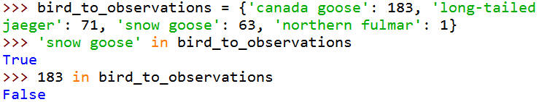
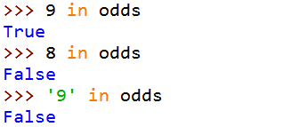
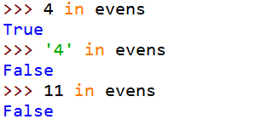
In operator on tuples, sets, and dictionaries
Checks whether an item is a member of a tuple or a set
Checks whether a value is a key in the dictionary
The values in the dictionary are ignored

Slide 32
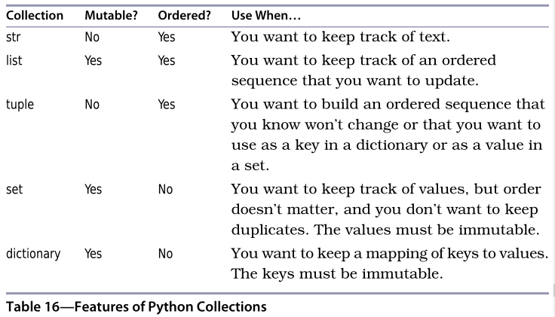
Comparing collections

Slide 33
Summary
Sets are used in Python to store unordered collections of unique values. They support the same operations as sets in mathematics.
Tuples are another kind of Python sequence. Tuples are ordered sequences like lists, except they are immutable.
Dictionaries are used to store unordered collections of key/value pairs. The keys must be immutable, but the values need not be.
Looking things up in sets and dictionaries is much faster than searching through lists. If you have a program that is doing the latter, consider changing your choice of data structures.

Slide 34
Assignment
Ch. 11.8 Exercises

